Slide 1
Session 1: Course introduction
C4E - Fundamentals

Slide 2
Agenda
Course introduction
Course overview
Milestones
Hackathon
Command line or Terminal basics
Python getting started
Installation
Hello world
Variables
Loops

Slide 3
Course introduction

Slide 4
Course overview
Goals:
Programming fundamentals: knowledge and skills
Learning skills:
Textbook reading
Search
Code sample reading

Slide 5
What programming language?

Slide 6


Slide 7
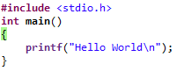
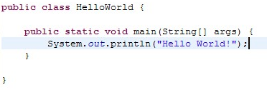
Why Python?
C
Easy to start, easy to learn
Java
Python

Slide 8




Why python?

Slide 9
Why python
References: https://insights.stackoverflow.com/survey/2017#technology-most-loved-dreaded-and-wanted-languages

Slide 10
The milestones

Slide 11
Basic
(5 - 6 sessions)
Lab
(3 sessions)
Web
(8 sessions)
Hackathon
Notes:
Nhắc đến chuyện học là phải làm

Slide 12
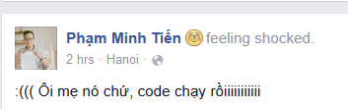
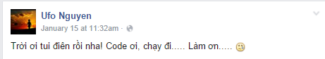
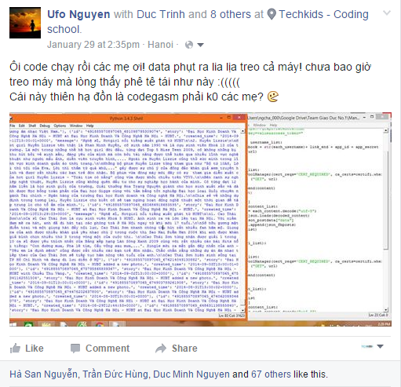
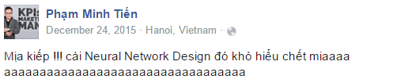

Slide 13
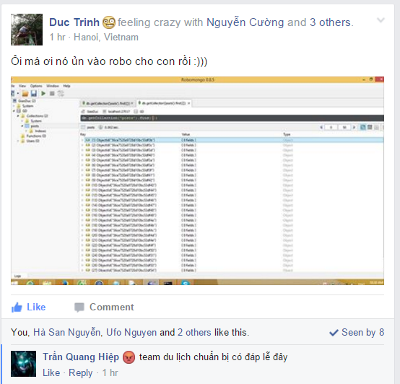
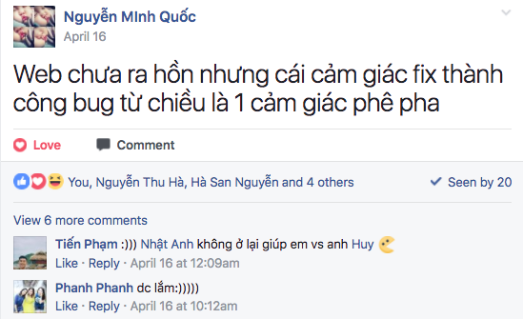
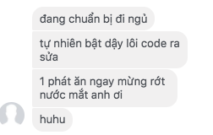

Slide 14
Project and the Hackathon

Slide 15
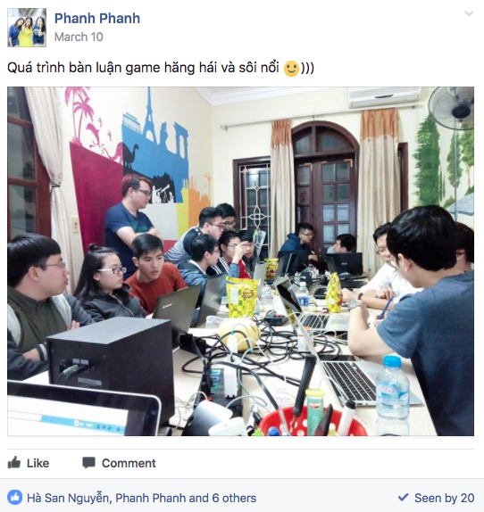

Slide 16
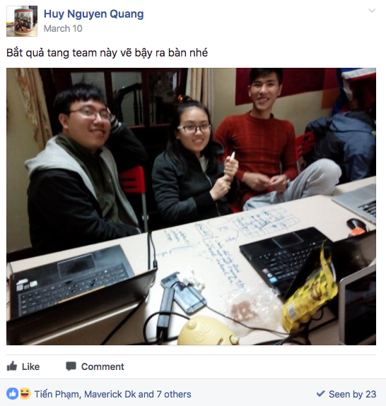

Slide 17
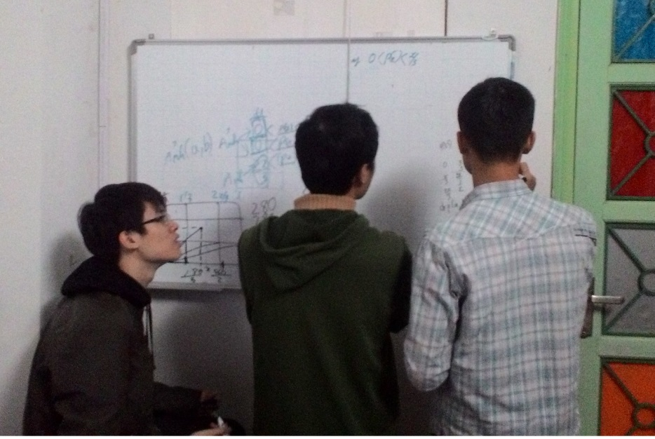
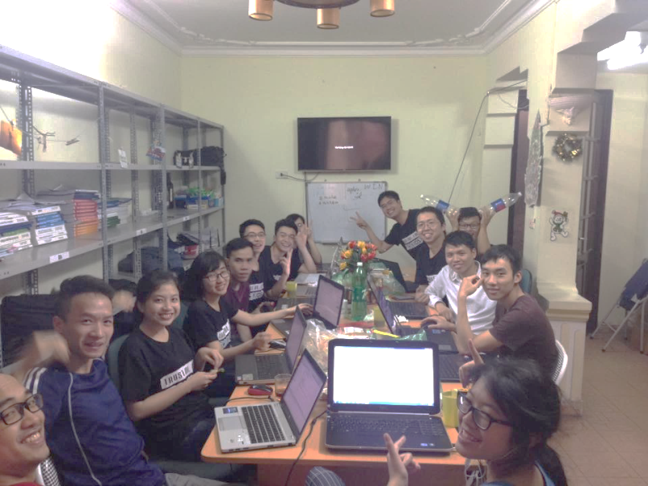
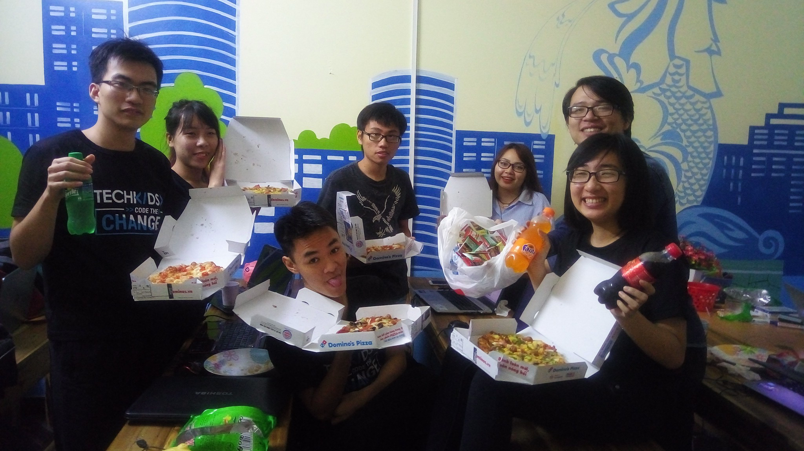
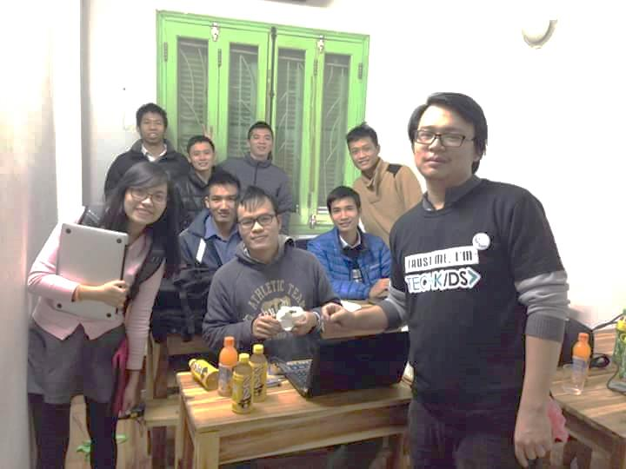

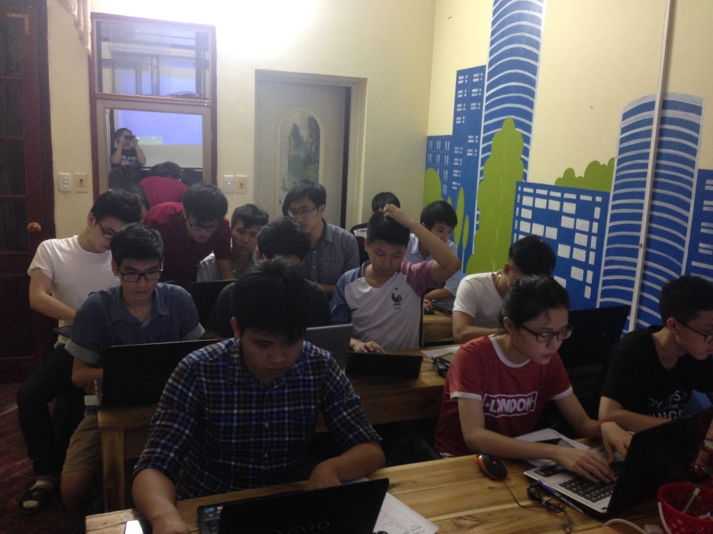
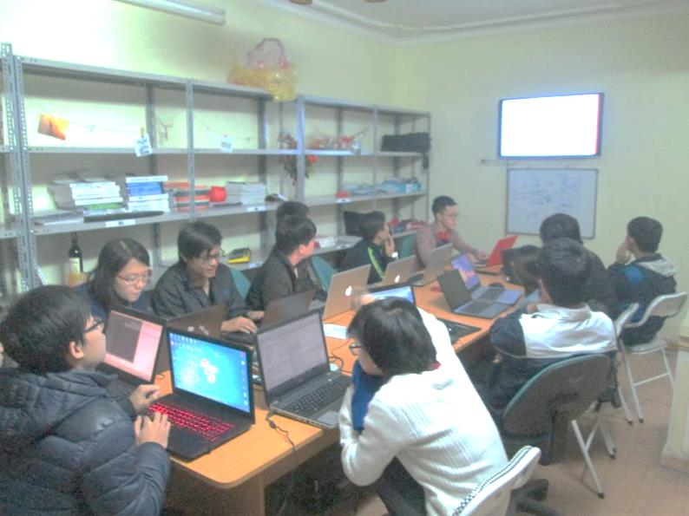

Slide 18
Final results

Slide 19
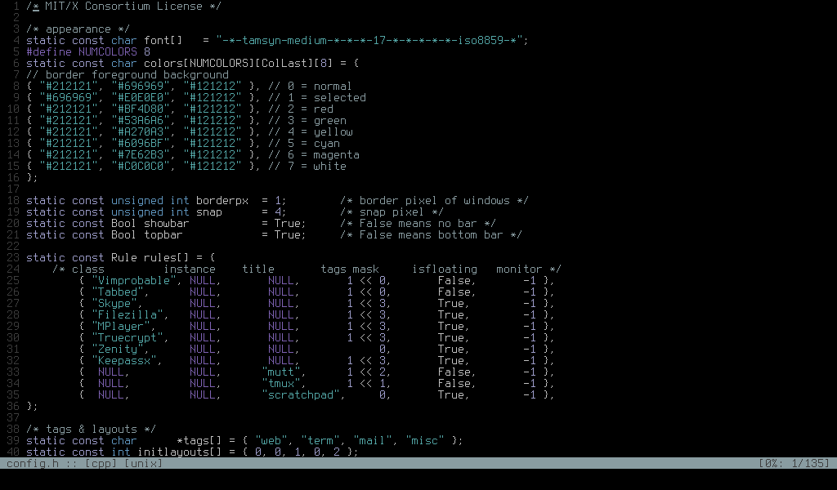
Final results
Web
Front-end, back-end, database
Console application

Slide 20
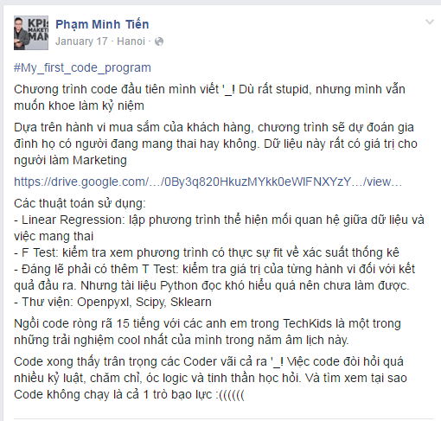

Slide 21
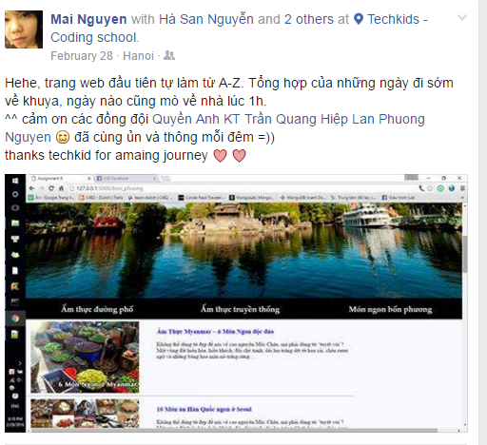

Slide 22
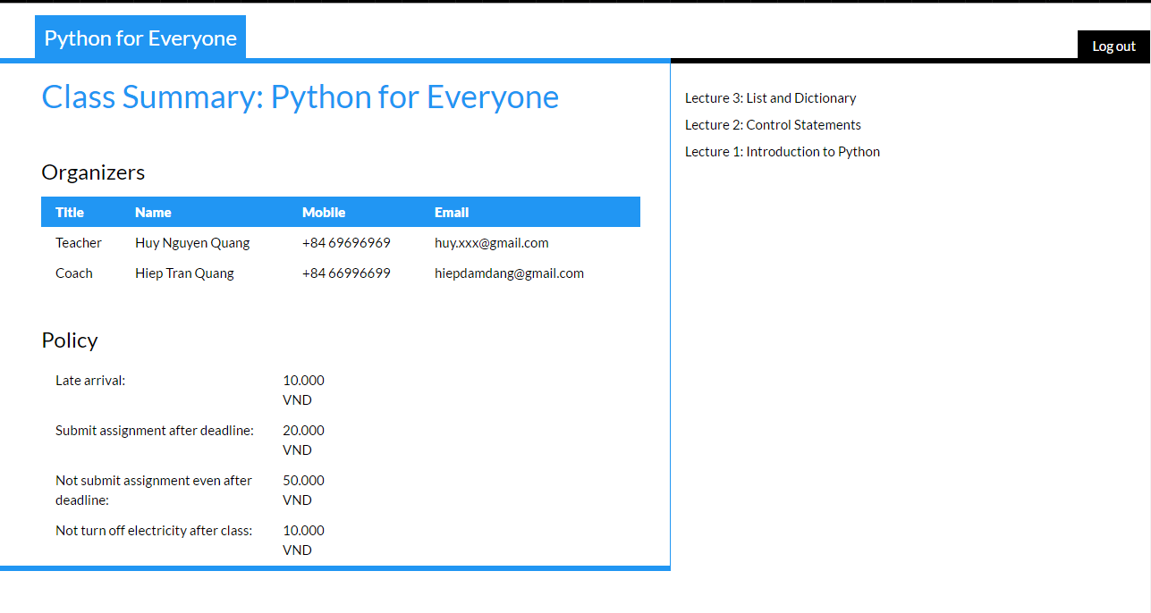

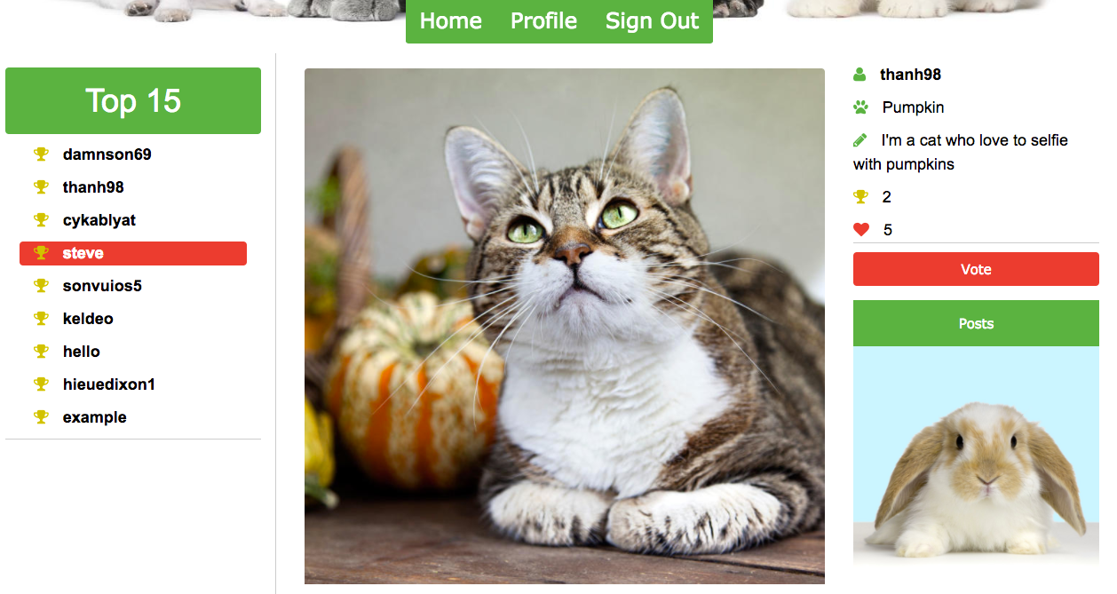
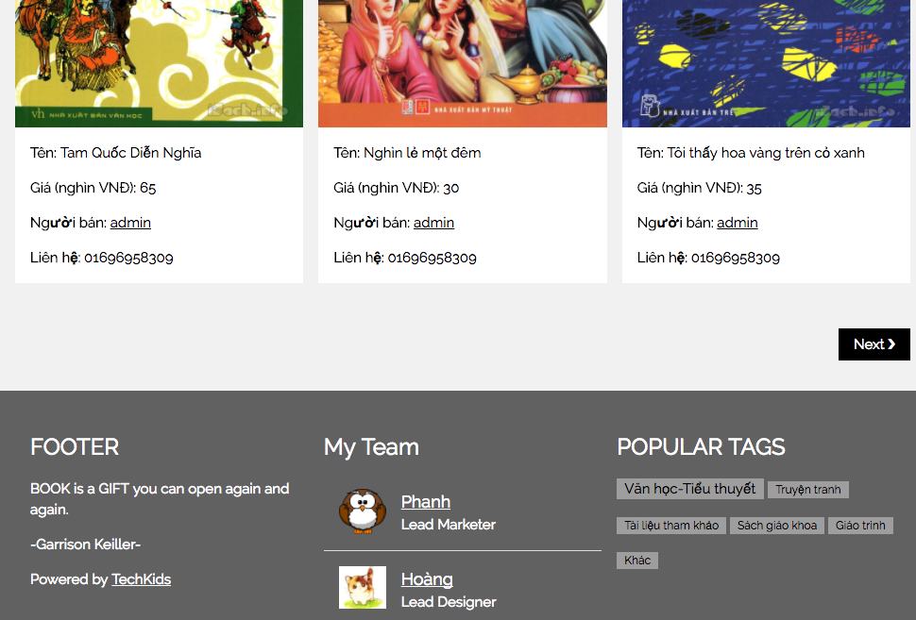

Slide 23
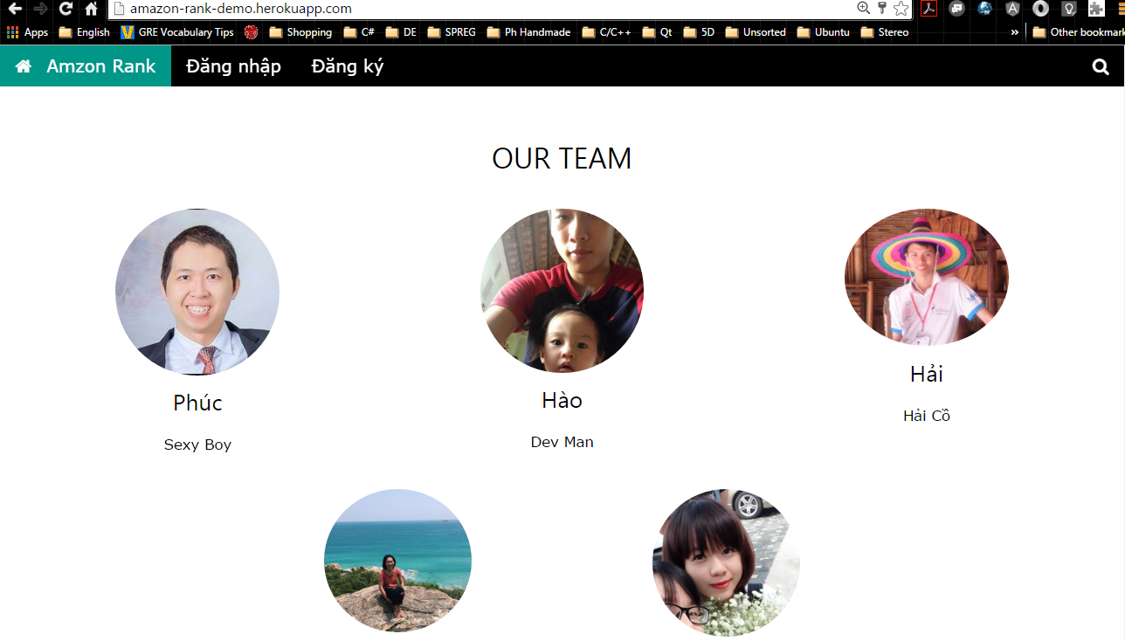

Slide 24


Slide 25


Slide 26


Slide 27


Slide 28
Some other notes
100, 50, and 20 rules

Slide 29
Some computer “basics”

Slide 30
Folder structure
References: http://support.sas.com/documentation/cdl/en/bisag/64088/HTML/default/viewer.htm#a003252245.htm
Notes:
How many folders?
Highest level folder
Lowest level folder

Slide 31
Folder structure
Highest level
Lowest levels

Slide 32
Folder structure

Slide 33
Folder structure

Slide 34
Folder structure
From “SAS Folders”, how to go to
“Department 3” of “Division B”?
SASFolder => Division B => Department 3

Slide 35
Folder structure
From “Department 3” of “Division B”, how to go to
“FY 2008” of “Division A Data”?
Deparment 3 => Division B => Division A Data => FY 2008

Slide 36
Terminal / Command line basics commands

Slide 37
Cheatsheet
Command | Windows | MAC / Linux
Go to folder (Change directory) | cd <folder_name> | cd <folder_name>
Go back one folder | cd .. | cd ..
Create a new folder | mkdir <folder_name> | mkdir <folder_name>
List all files and folder | dir | ls

Slide 38
Python getting started

